Slide 1
Library Management systems.

Slide 2
Class and Struct UsageClasses:
Classes (Library) and structs (Student and Book) are used to encapsulate data and behavior. Student and Book are simple data structures, while Library includes both data members and methods to manage the library system.

Slide 3
Encapsulation
The Library class encapsulates data and methods. Access to some of this data is controlled by using private access specifiers, allowing interaction through public methods.

Slide 4
Dynamic memory allocation
Dynamic memory is allocated using new for students and books. This allows the program to handle an arbitrary number of books and students, only limited by system memory.

Slide 5
Array of pointers
Dynamic memory is allocated using new for students and books. This allows the program to handle an arbitrary number of books and students, only limited by system memory.

Slide 6
Hashing and hash Tables
Hashing is used to locate students by their roll number efficiently. The hashFunction calculates the index in table for each student, based on their roll number modulo table_size forming a basic hash table.

Slide 7
Friend Functions
Friend functions (addBook, issueBook, returnBook) have access to the private members of the Library class. This demonstrates how friend functions can operate on private data of the class without being member functions.

Slide 8
Function overloading and constructors
Constructor overloading is used for the Student and Book structs, providing both default and parameterized constructors to initialize data.

Slide 9
Control Flow
Conditionals (if and else statements) and loops are used to control program flow. For instance, for loops are used to iterate through books, and if statements check conditions like book availability.

Slide 10
Error Handling and User Feedback
The program checks conditions like book availability and student registration status, providing feedback if an action cannot be completed (e.g., issuing a book when no copies are available).

Slide 11
Pointer Operations
Pointer operations are utilized in dynamic memory allocation, accessing data members, and managing arrays. For example, Book* temp temporarily stores book data when expanding the books array dynamically.

Slide 12
Friendship in Classes
The concept of friendship in classes is shown where the functions addBook, issueBook, and returnBook are declared as friends of Library. This allows these functions to access the private members of Library directly.

Slide 13
Function Modularization
Each function has a specific role, making the code modular and easier to maintain. For example, displayBooks, issueBook, and returnBook handle different tasks independently.

Slide 14
Object-Oriented programming principles
The code demonstrates oops principles like encapsulation, modularity, and data abstraction, particularly within the Library class, which provides a simple interface for managing library operations.

Slide 15
Data Abstraction
Data abstraction is achieved by exposing essential functionalities (like registering students and issuing books) while hiding implementation details within the Library class.

Slide 16
These concepts work together to create a simplified library management system, highlighting the effective use of C++'s object-oriented and memory management capabilities.

Slide 17
The Code

Slide 18
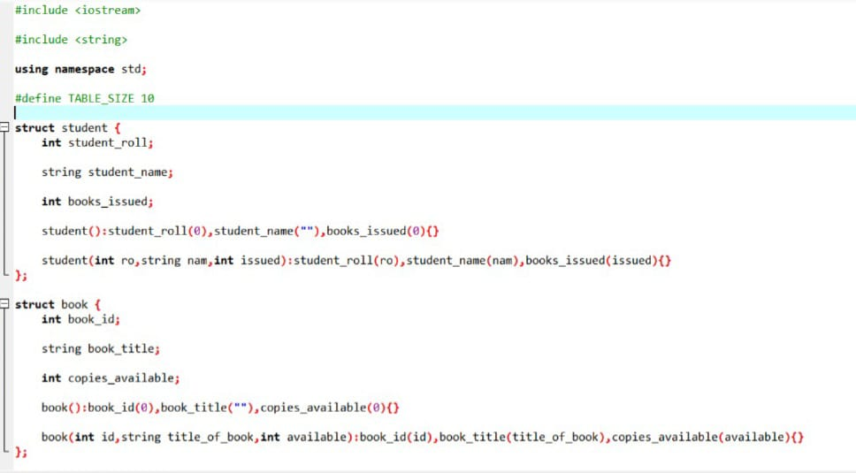

Slide 19
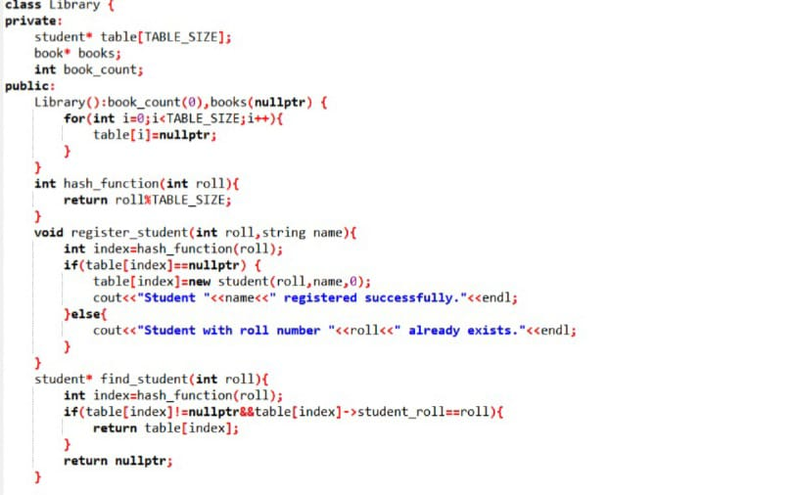

Slide 20
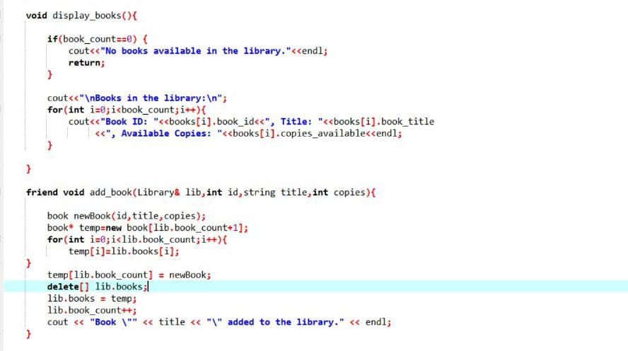

Slide 21
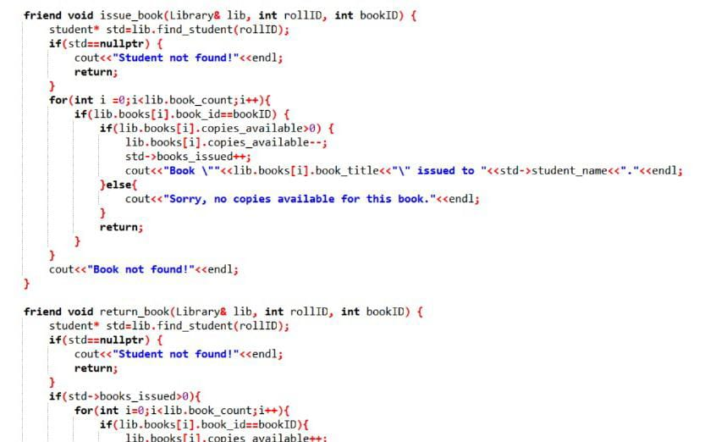

Slide 22
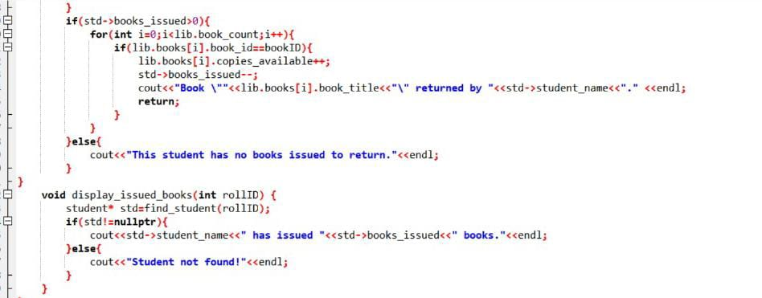

Slide 23
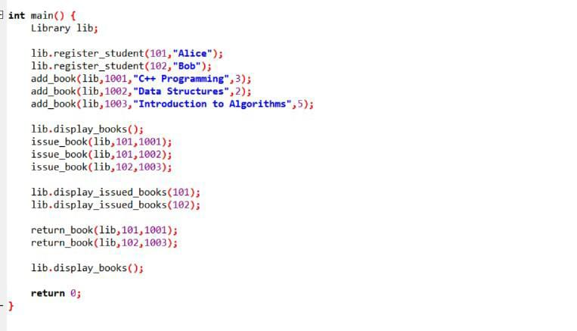

Slide 24
The Output

Slide 25
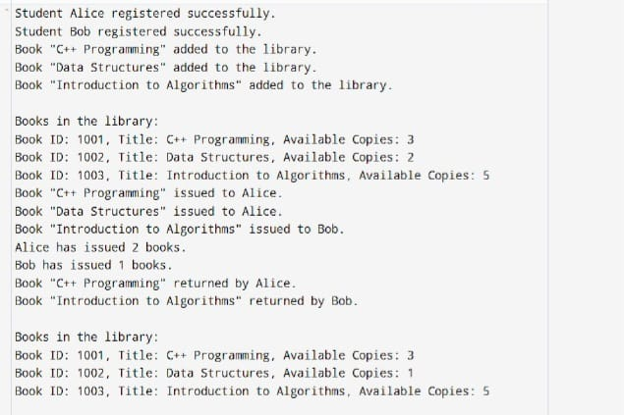

Slide 26
Group Members.
S.Meghana(AP23110011415)
P.Devi(AP23110011419)
S.Ruhi(AP23110011443)
M.Jahnavi(AP23110011445)

Slide 27
Thank you!

